Slide 1
Technical Publication and LaTeX

Slide 2
Content of Technical Publications
Conventions of a Report/Technical Paper
Generic Report Format
Typesetting and Font Face

Slide 3
Conventions of a Report/Technical Paper
Minimum Standard
Formal Writing
Avoid Contractions
Written in 3rd Person
No Personal Pronouns
E.g. I, We
Written in PAST tense
Past Perfect (Preferred)
Past Imperfect (Accepted)
Quality Standard
Most sentences of the form {Subject} followed by {Predicate}.
The cat was sick.
Our results agreed with the predictions.
Consult, “The Principles of Poor Writing” by Paul W. Merrill

Slide 4
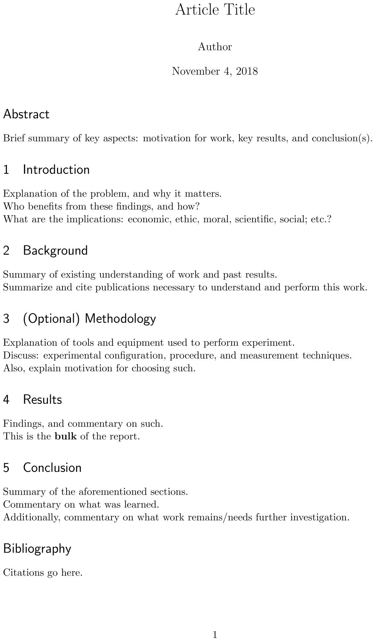
Generic Report Format
Simplest format typically has 4 (numbered) sections, an abstract, and a bibliography.
The Abstract is a summary of all other results to follow. Consider writing it last.
For an more in-depth discussion of each section, consider reading:
“Preparing manuscript: Scientific writing for publication” by Sukhminder Jit Singh Bajwa and Chhavi Sawhney.
“The Structure, Format, Content, and Style of a Journal-Style Scientific Paper” published by the Biology department of Bates College.
On the topic of abstracts, consider reading:
“How to write a good abstract for a scientific paper or conference presentation” by Chittaranjan Andrade

Slide 5
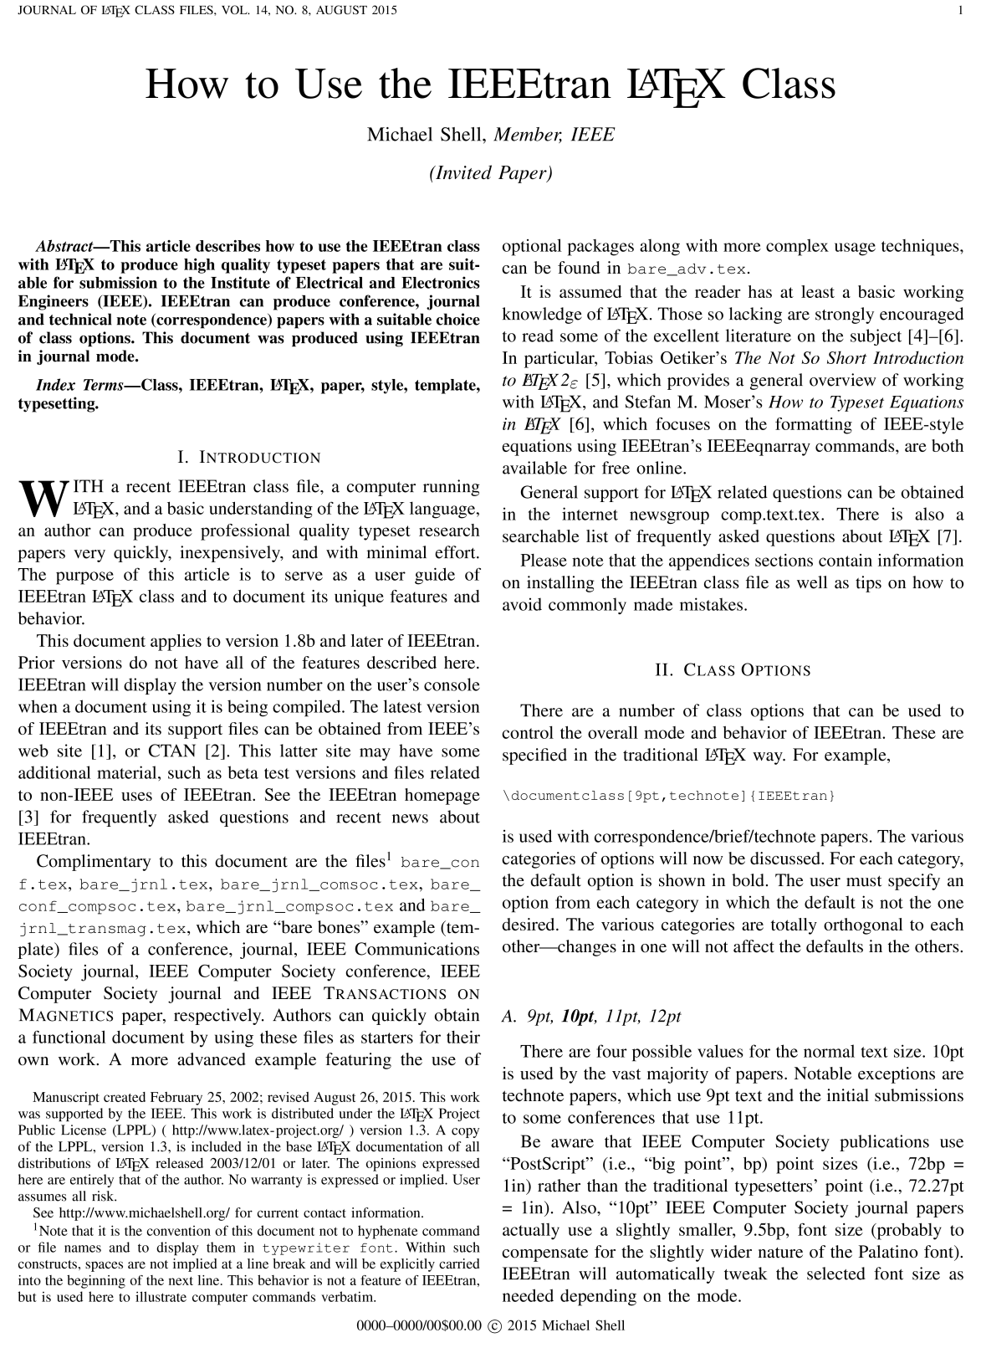
Typesetting and Font Face
Templates for the document being prepared are typically provided of particular interest:
ACM Master Article Template
AMS TeX Resources
APS REVTeX
ASME Journal and Conference Papers
IEEE Article Templates
Try: Template for Transactions
(Unofficial) SPIE Proceedings Template
LaTeX offers a coding-type user experience:
The user inputs the raw text, and syntactically describes how to interact with it.
The resulting document is programmatically generated from the description the end-user provides.
Importantly: A well described document is easier to generate correctly, than to generate using crude work-arounds. This is the most prominent issue with allowing users to generate documents in modern editors.

Slide 6
Basics of LaTeX
Requirements
Anatomy of LaTeX Source File
Principle Text Commands
Equations
Figures
Lists
Tables

Slide 7
Requirements
LaTeX is a Compiled Language
A Compiler is needed
Consider MiKTeX (Offers on-the-fly package installation)
Editor is Needed
Consider TeXworks (Minimal Environment)
Consider TeXstudio (Development Environment)
LaTeX is often extended using 3rd party libraries
CTAN: Comprehensive TeX Archive Network
Archives most packages of interest and their documentation.

Slide 8
Anatomy of a LaTeX Source File
Defines the Document Type
“article” is a class file that defines formatting
“11pt” is an input parameter to the “article” class
\documentclass[11pt]{article}
\usepackage[utf8]{inputenc}
\title{Article Title}
\author{Author}
\date{\today}
\begin{document}
\maketitle
\end{document}
Import/Include of 3rd party modules
“inputenc” is the name of the package
“utf8” is an input parameter
Preamble
Designates document title
Designates document author
Designates today as document date
Invokes the Title
Content of Document Goes Here
Body
Note: When Publishing, the document class is typically provided, and the body of the document will largely remain the same. Some tweaks may be needed.

Slide 9
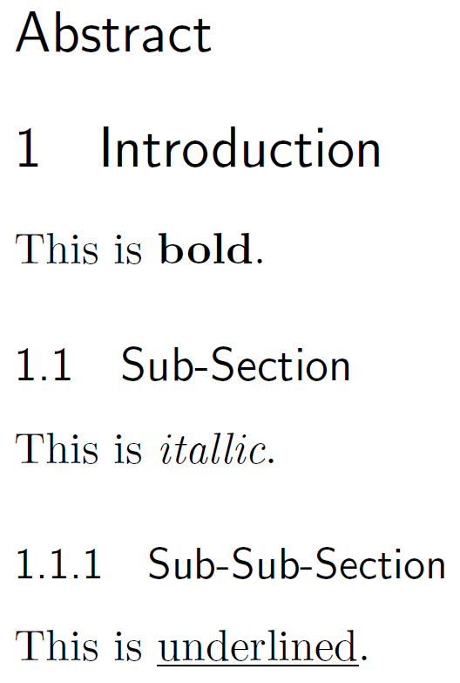
Principle Text Commands
\section*{Abstract}
\section{Introduction}
This is \textbf{bold}.
\subsection{Sub-Section}
This is \textit{itallic}.
\subsubsection{Sub-Sub-Section}
This is \underline{underlined}.
https://www.overleaf.com/learn/latex/Sections_and_chapters

Slide 10
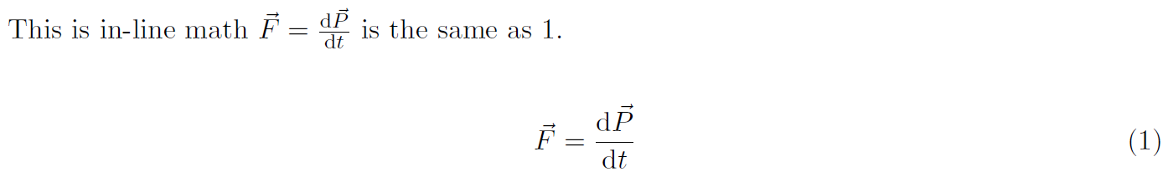
Equations
Inline equations are placed inside $math$.
Generally, use the align environment.
This is in-line math $\vec{F} = \frac{\mathrm{d}\vec{P}} {\mathrm{d}t} $ is the same as \ref{eq1}.\\
\begin{align}
\vec{F} &= \frac{\mathrm{d}\vec{P}} {\mathrm{d}t} \label{eq1}
\end{align}
Numerator
Denominator
Reference to equation by name
Allows Reference by name

Slide 11
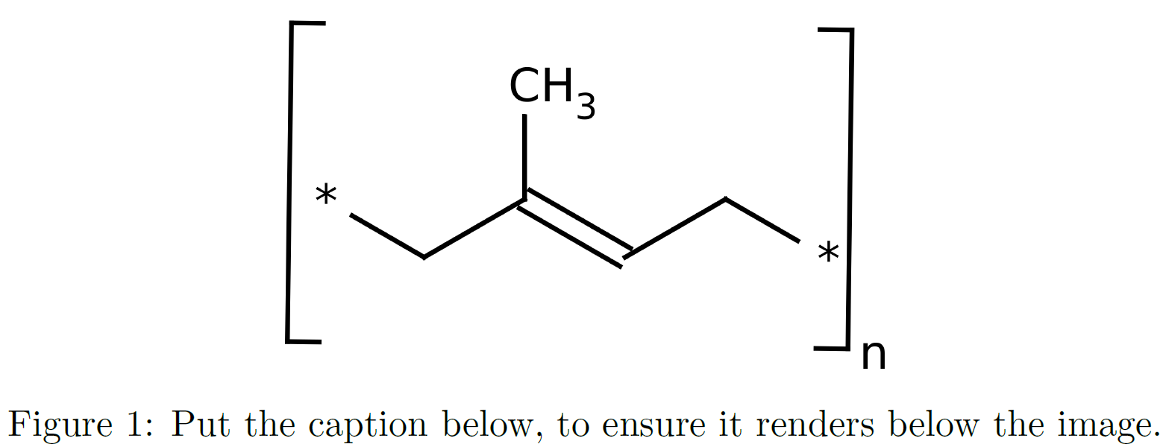
Figures
To include externally generated images or plots uses the figure environment.
\begin{figure}[h!] % h! (Please) Put Figure Here
\centering % Center The Figure
\includegraphics[width = 2.5 in]{image.png}
\caption{Put the caption below, to ensure it renders below the image.}
\label{fig1}
\end{figure}
https://commons.wikimedia.org/wiki/File:Trans-poly-isoprene-1,4.svg

Slide 12
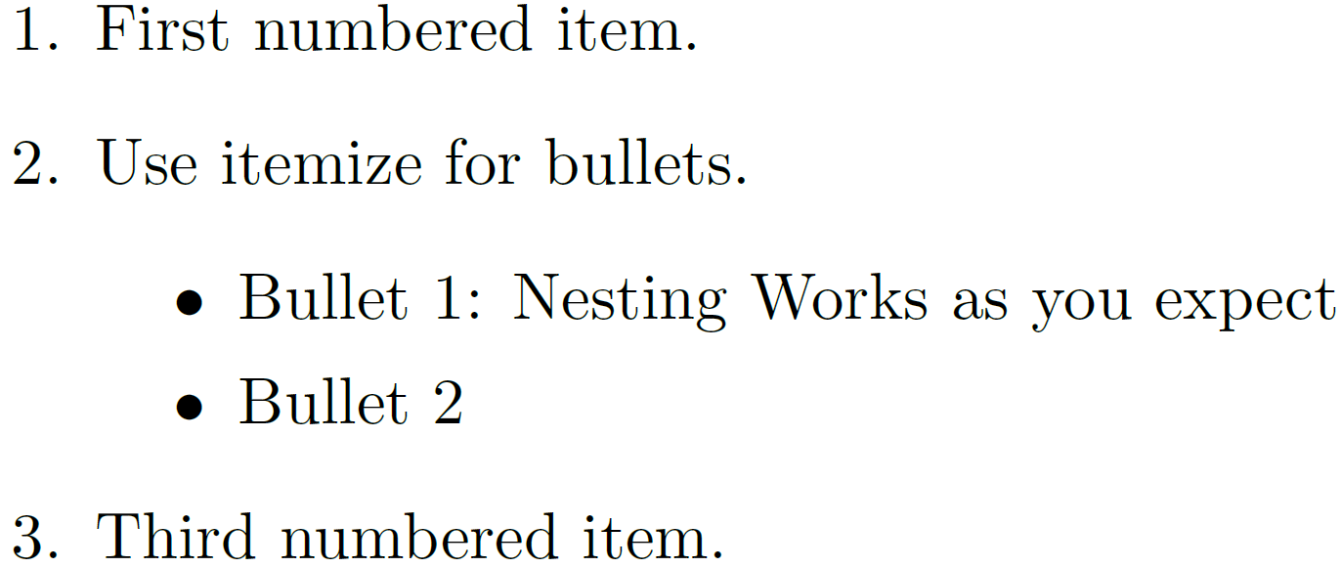
Lists
\begin{enumerate}
\item First numbered item.
\item Use itemize for bullets.
\begin{itemize}
\item Bullet 1: Nesting Works as you expect
\item Bullet 2
\end{itemize}
\item Third numbered item.
\end{enumerate}

Slide 13
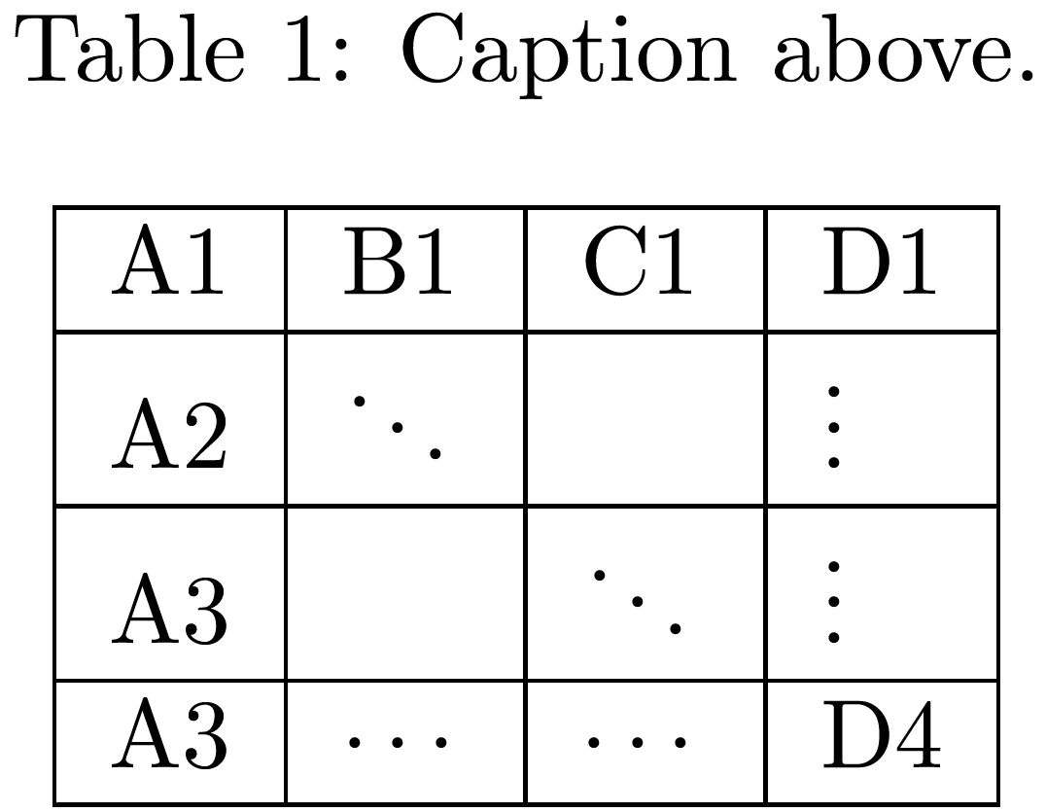
Tables
Consider Using https://www.tablesgenerator.com
\begin{table}[h!] % h! (Please) Put Figure Here
\centering % Center The Figure
\caption{Put the caption above.}
\label{tab1}
\begin{tabular}{| l | l | l | l | l |}
\hline A1 & B1 & C1 & D1 \\ \hline
A2 & $\ddots$ & & $\vdots$\\ \hline
A3 & & $\ddots$ & $\vdots$\\ \hline
A3 & $\cdots$ & $\cdots$ & D4 \\ \hline
\end{tabular}
\end{table}

Slide 14
Recommended Packages
Algorithm2e
AMS Math
Array
Geometry
Graphics
Hyperref
Listings
Xcolor

Slide 15
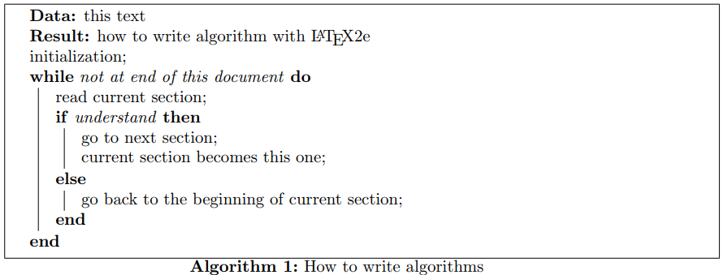
Recommended Packages: Algorithm2e
Provides environment for describing algorithms
Algorithm2e (Documentation)
https://en.wikibooks.org/wiki/LaTeX/Algorithms#Typesetting_using_the_algorithm2e_package
\usepackage {algorithm2e}
Algorithm 1 from algorithm2e base documentation linked above.

Slide 16
Recommended Packages: AMS Math
Provides powerful mathematical support
AMS Math (Documentation)
https://en.wikibooks.org/wiki/LaTeX/Advanced_Mathematics
\usepackage[cmex10]{amsmath} % use type1 fonts
\usepackage {amssymb} % Names individual symbols

Slide 17
Recommended Packages: Array
Provides extended support to array and tabular environments.
Array (Documentation)
\usepackage[cmex10]{amsmath} % use type1 fonts
\usepackage {amssymb} % Names individual symbols

Slide 18
Recommended Packages: Geometry
Allows customization of page geometry
Geometry (Documentation)
\usepackage{geometry}
\geometry{letterpaper} % Use 8.5” x 11” paper
\geometry{margin=1in} % Use 1” Page Margins

Slide 19
Recommended Packages: Graphicx
Allows use of colors, provides graphics support
graphicx (Documentation)
\usepackage {graphicx}
% Including pictures and resizing becomes possible

Slide 20
Recommended Packages: Hyperref
Allows use hyperlinks within document
Hyperref (Documentation)
https://en.wikibooks.org/wiki/LaTeX/Hyperlinks#\hyperref
\usepackage [colorlinks = true,
linkcolor = blue,
urlcolor = blue,
citecolor = blue,
anchorcolor = blue]{hyperref}
% Change colorlinks to false if color un-desired.
Temperamental Package (WARNING): http://www.macfreek.nl/memory/LaTeX_package_conflicts

Slide 21
Recommended Packages: Listings
Allows use blocks of code within document
Listings (Documentation)
https://en.wikibooks.org/wiki/LaTeX/Source_Code_Listings
\usepackage{listings}

Slide 22
Recommended Packages: XColor
Allows use of colors.
xcolor (Documentation)
\usepackage[svgnames,table,hyperref]{xcolor}
% svgnames : Load Set of color according to SVG 1.1
% table : Load support for customizing table color
% hyperref : Load Support for Hyperref Package

Slide 23
Reference Guide to Symbols
Alphabets
Accents
Arrows and Arrow-Like Objects
Letters and Letter-Like Objects
Operators and Binary Relations

Slide 24
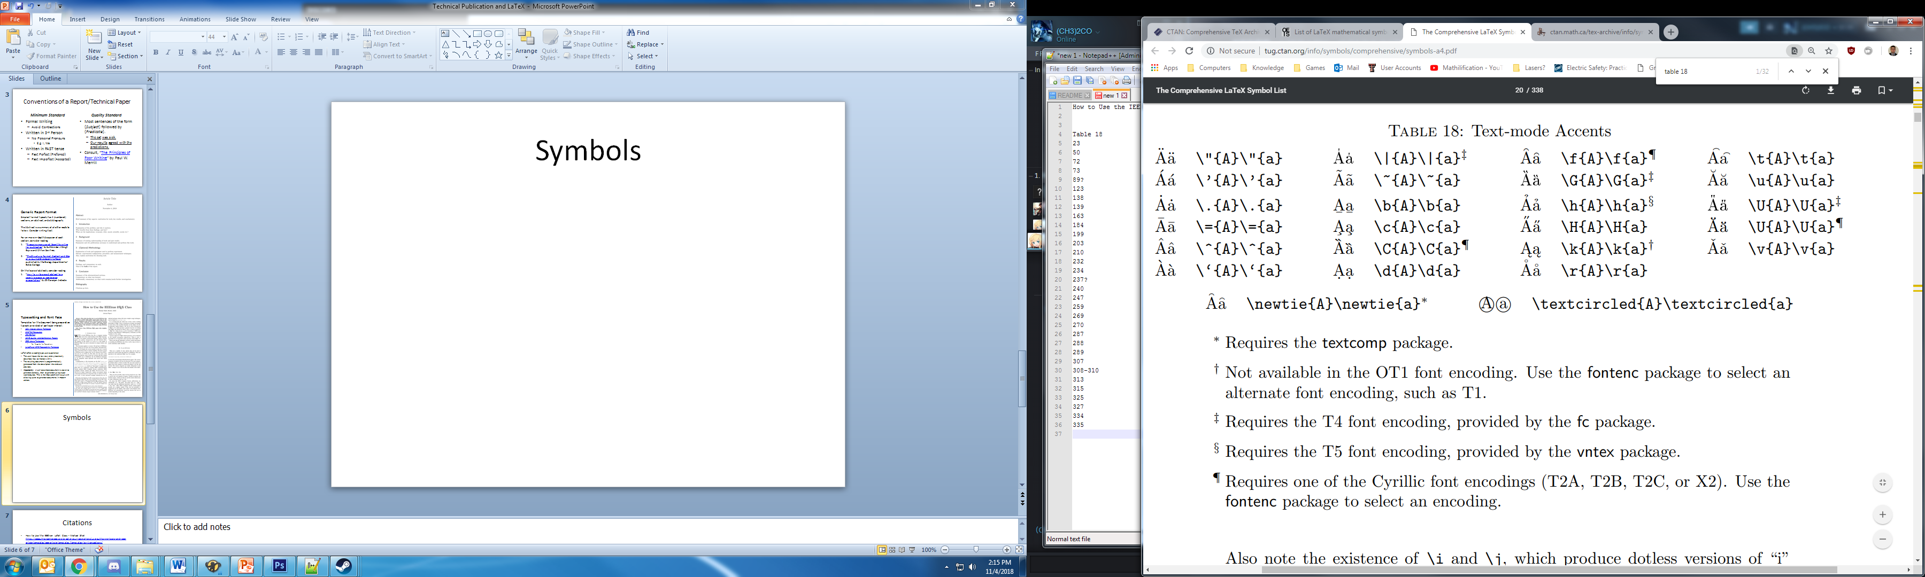
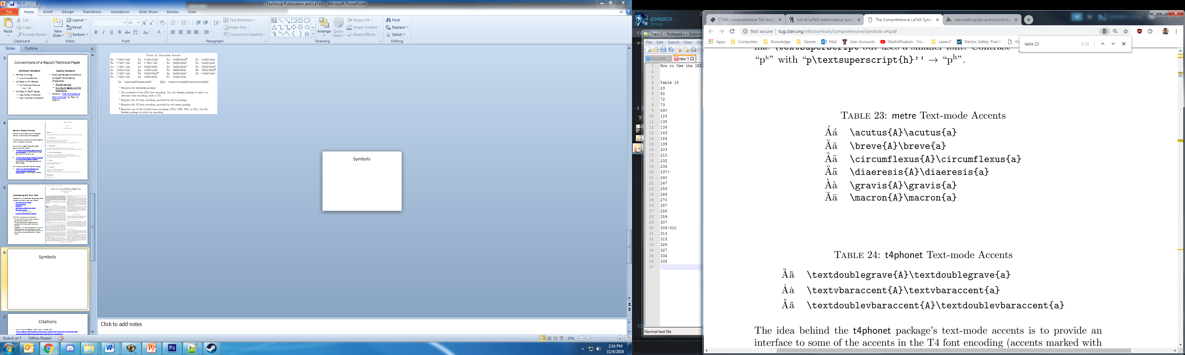
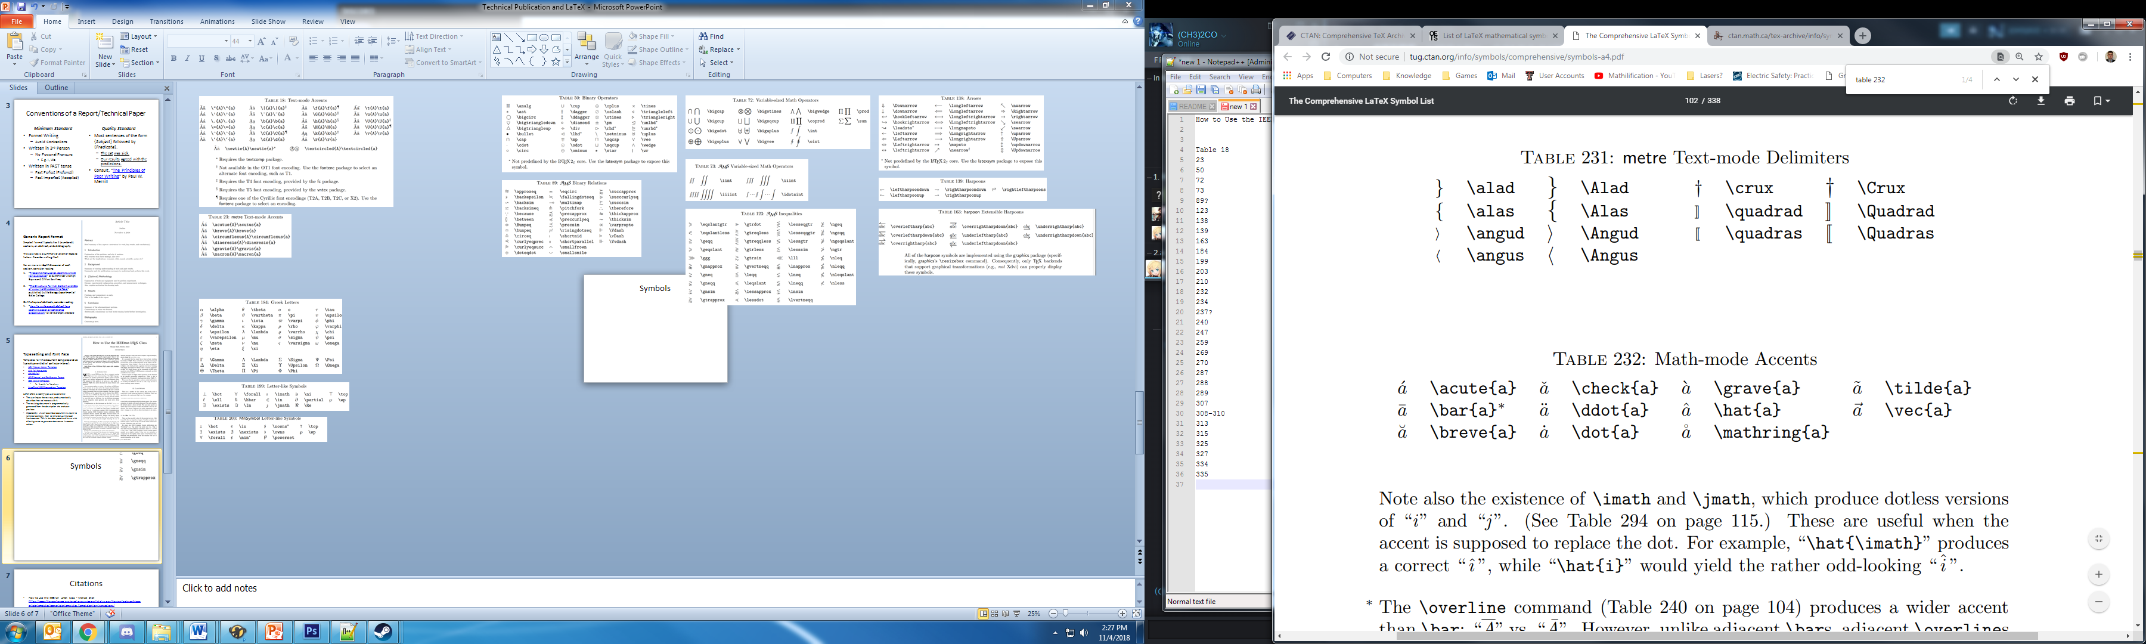
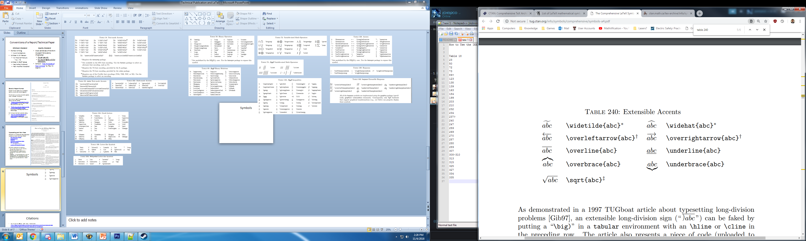
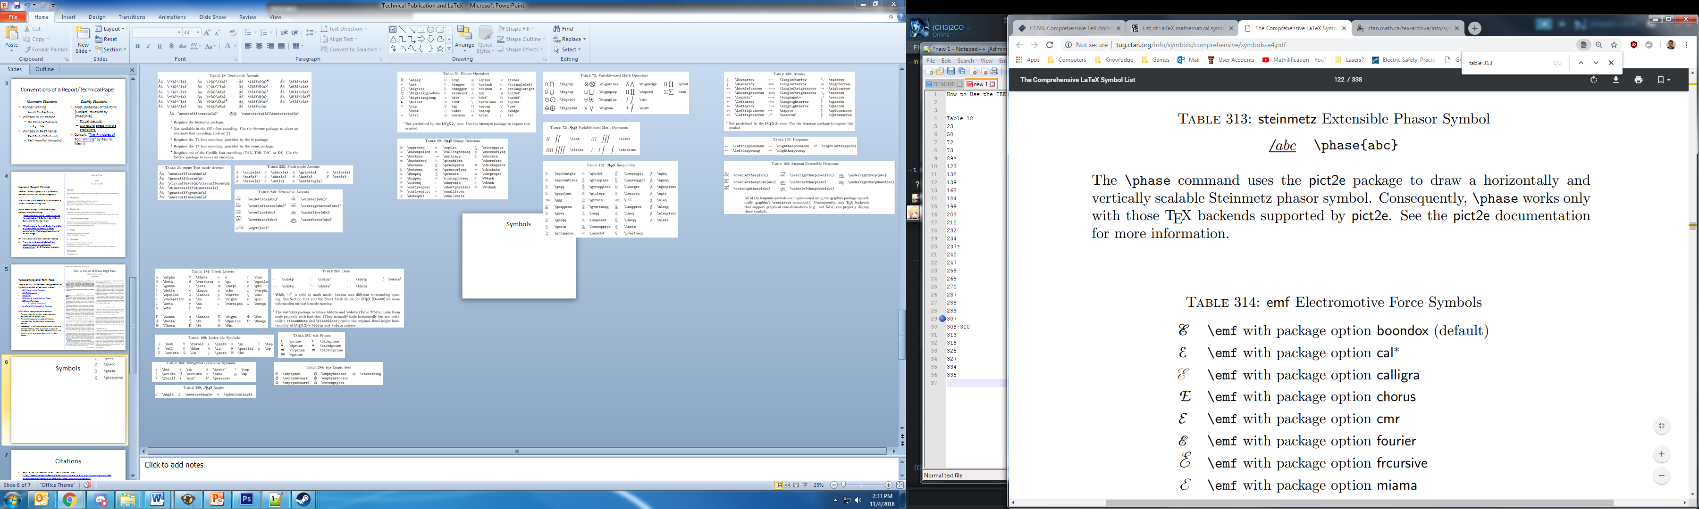
Symbols: Accents
All Tables are Taken From: “The Comprehensive LaTeX Symbol List” by Scott Pakin, January 19, 2017, online: http://tug.ctan.org/info/symbols/comprehensive/symbols-a4.pdf

Slide 25
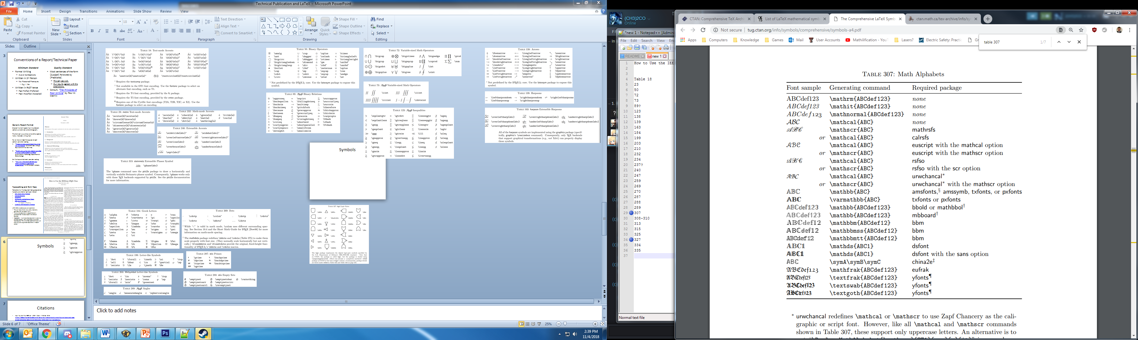
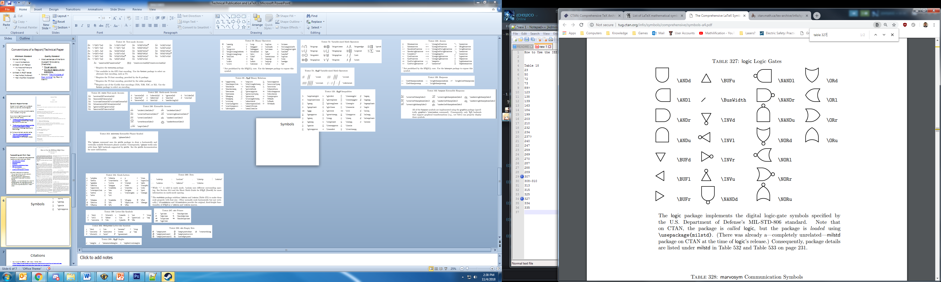
Symbols: Alphabets
All Tables are Taken From: “The Comprehensive LaTeX Symbol List” by Scott Pakin, January 19, 2017, online: http://tug.ctan.org/info/symbols/comprehensive/symbols-a4.pdf

Slide 26
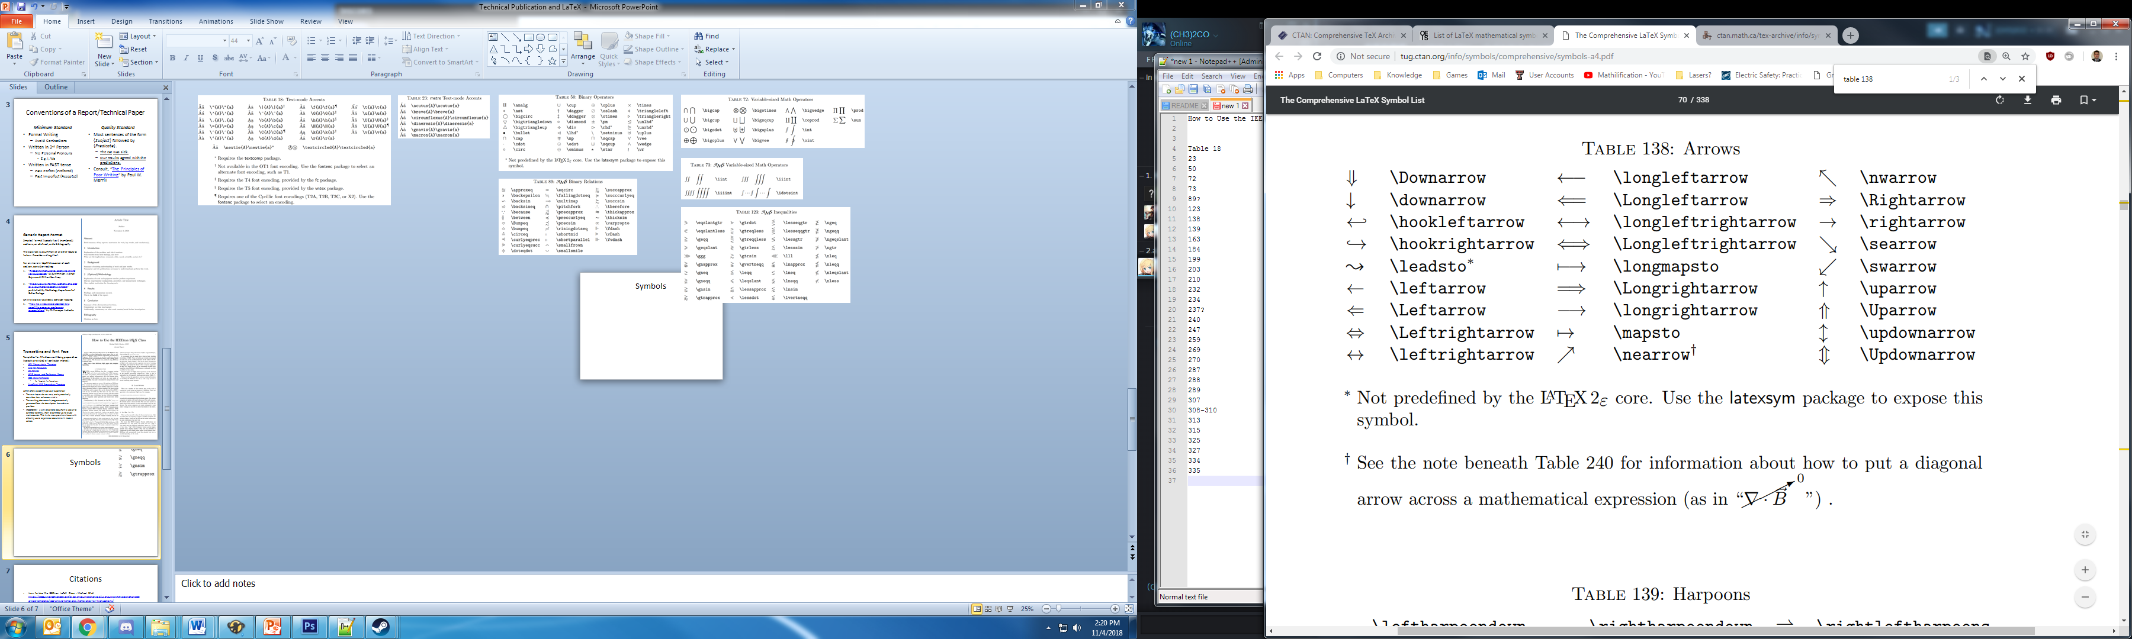
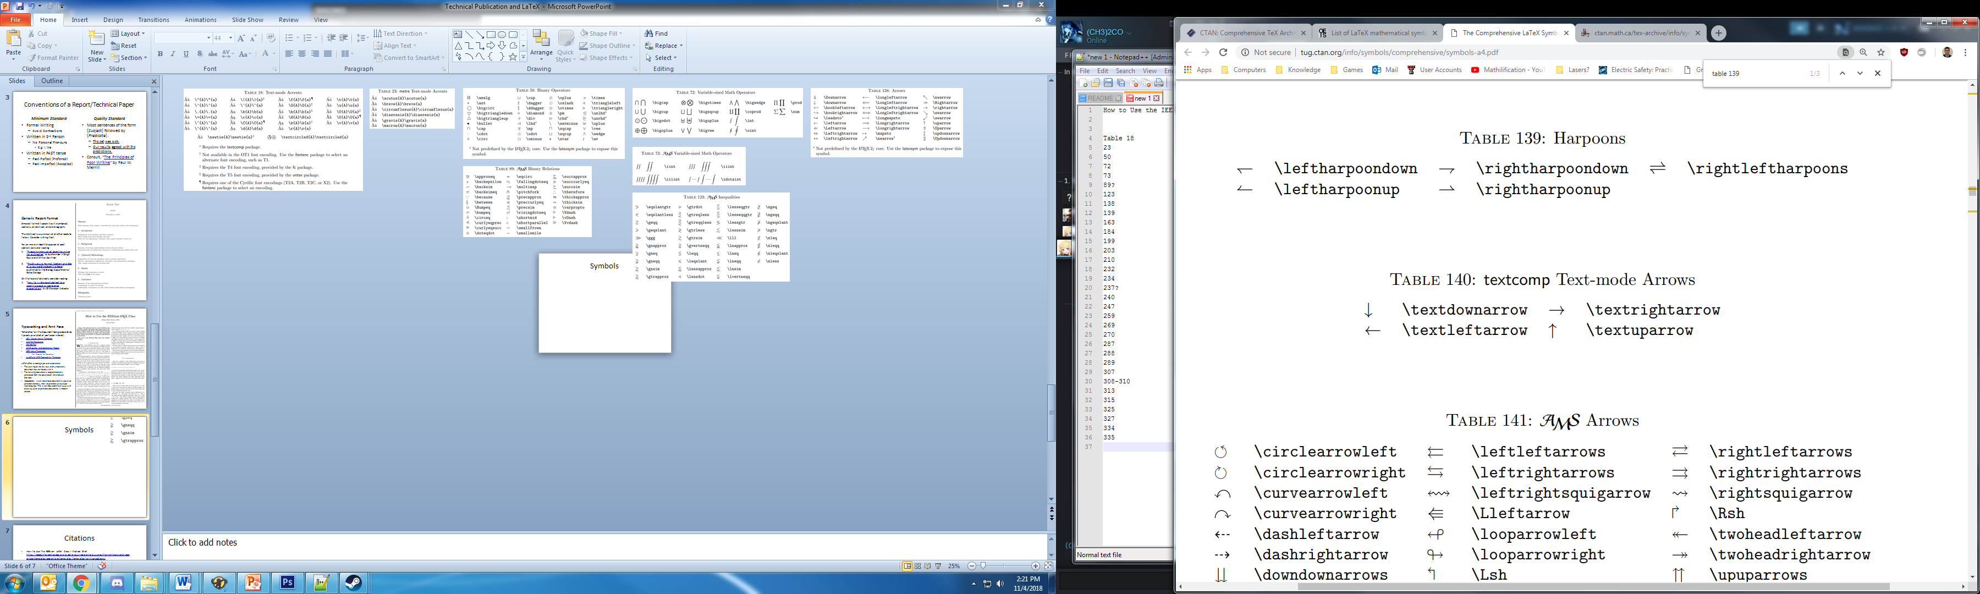
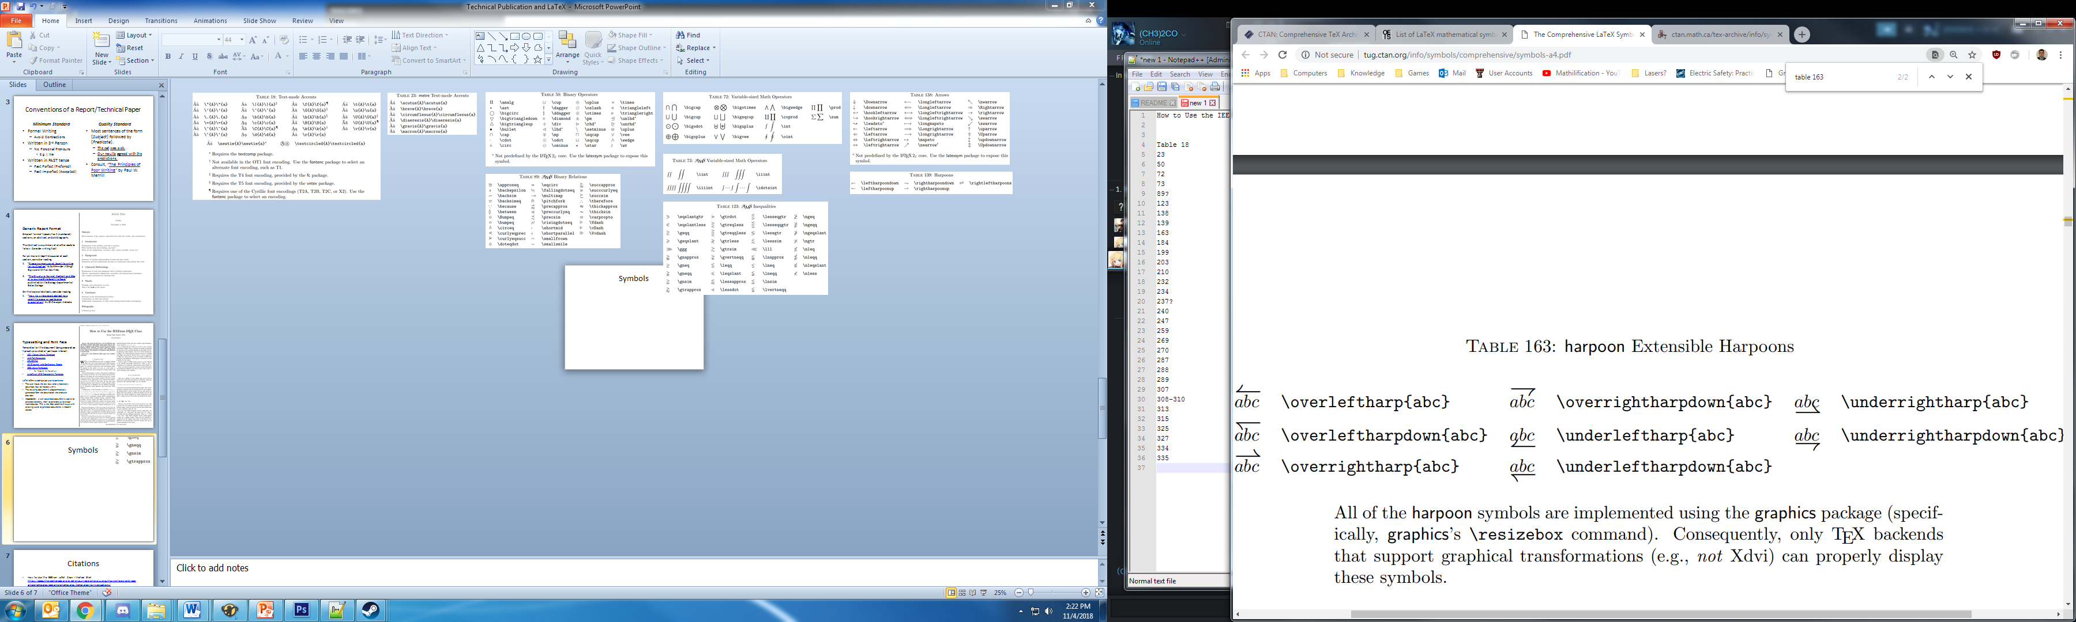
Symbols: Arrow & Arrow-Like
All Tables are Taken From: “The Comprehensive LaTeX Symbol List” by Scott Pakin, January 19, 2017, online: http://tug.ctan.org/info/symbols/comprehensive/symbols-a4.pdf

Slide 27
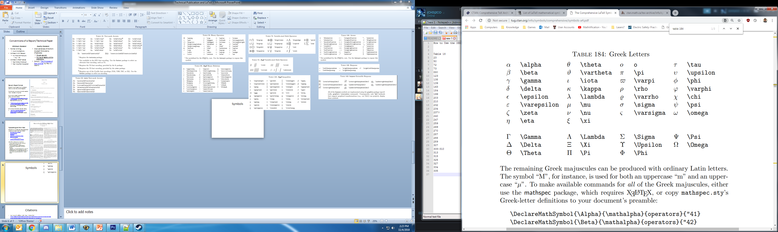
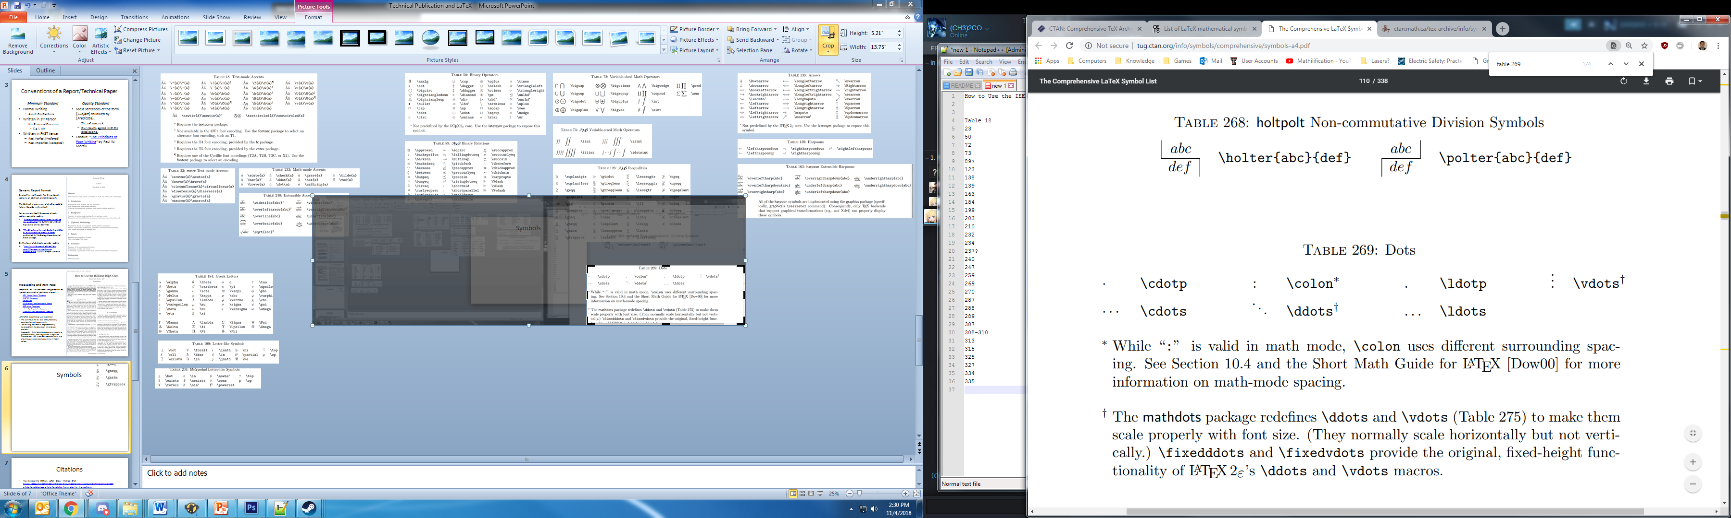
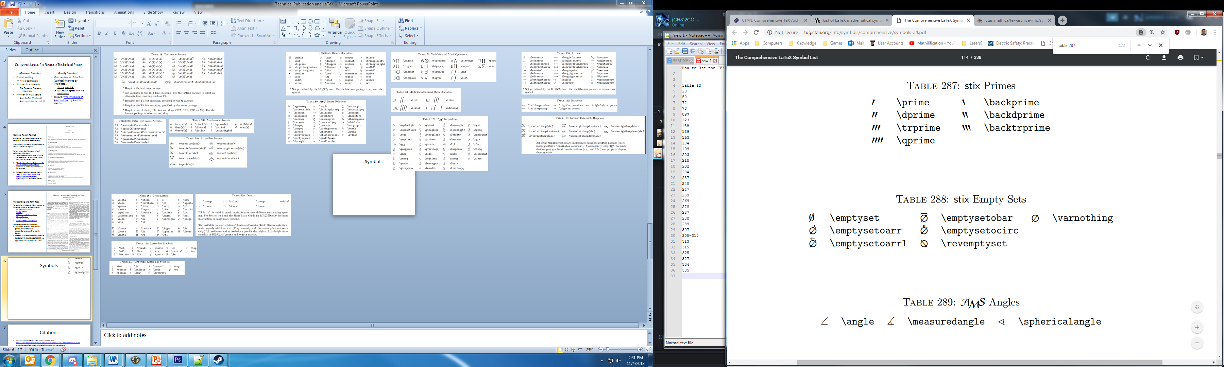
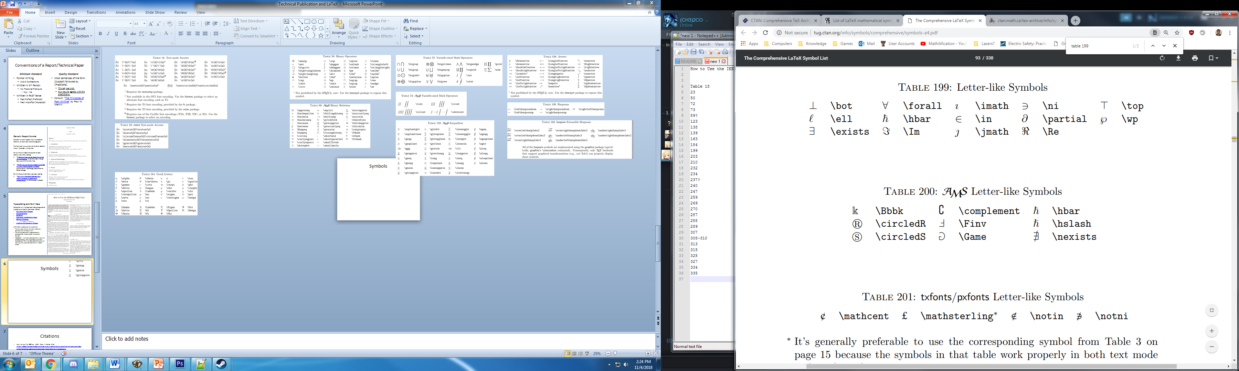
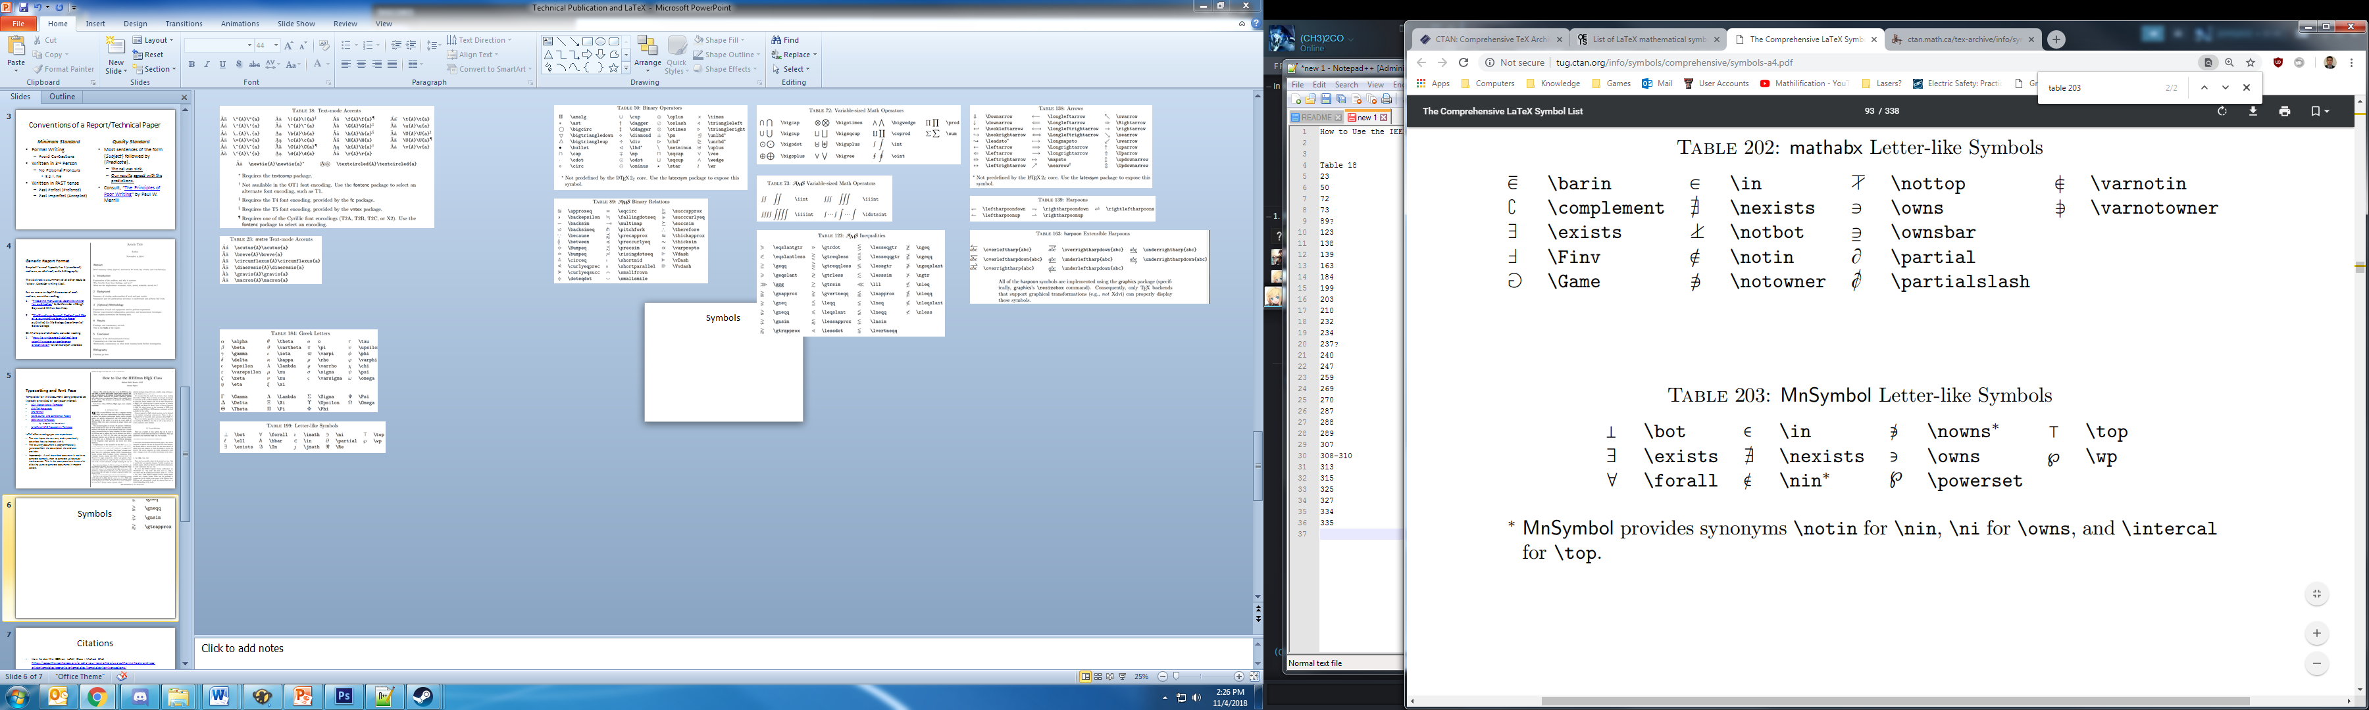
Symbols: Letter & Letter-Like
All Tables are Taken From: “The Comprehensive LaTeX Symbol List” by Scott Pakin, January 19, 2017, online: http://tug.ctan.org/info/symbols/comprehensive/symbols-a4.pdf

Slide 28
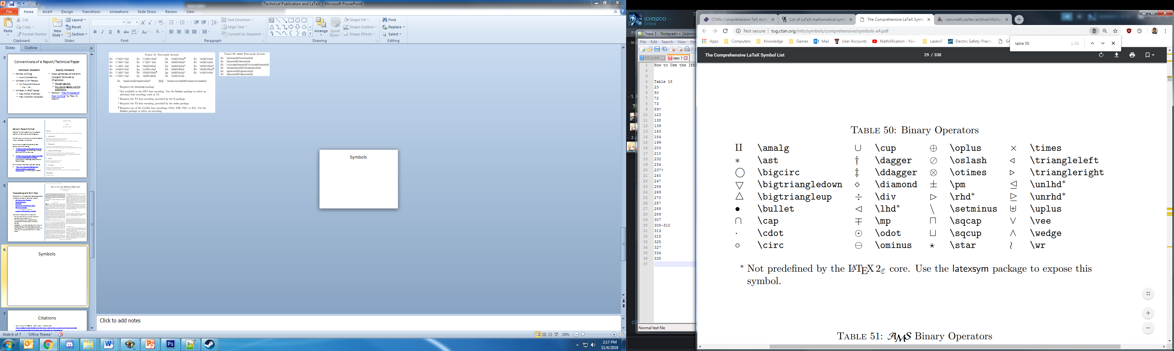
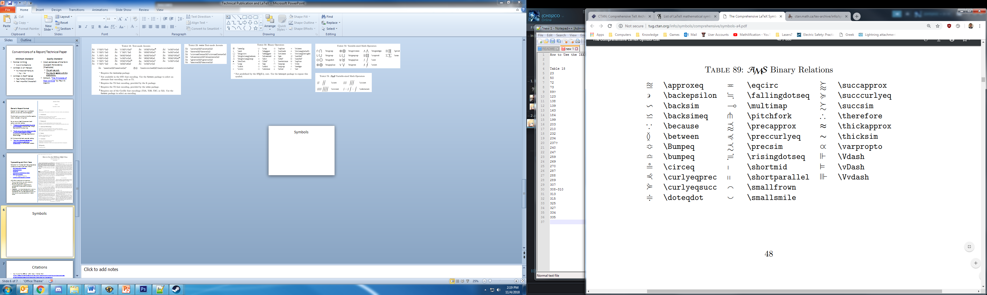
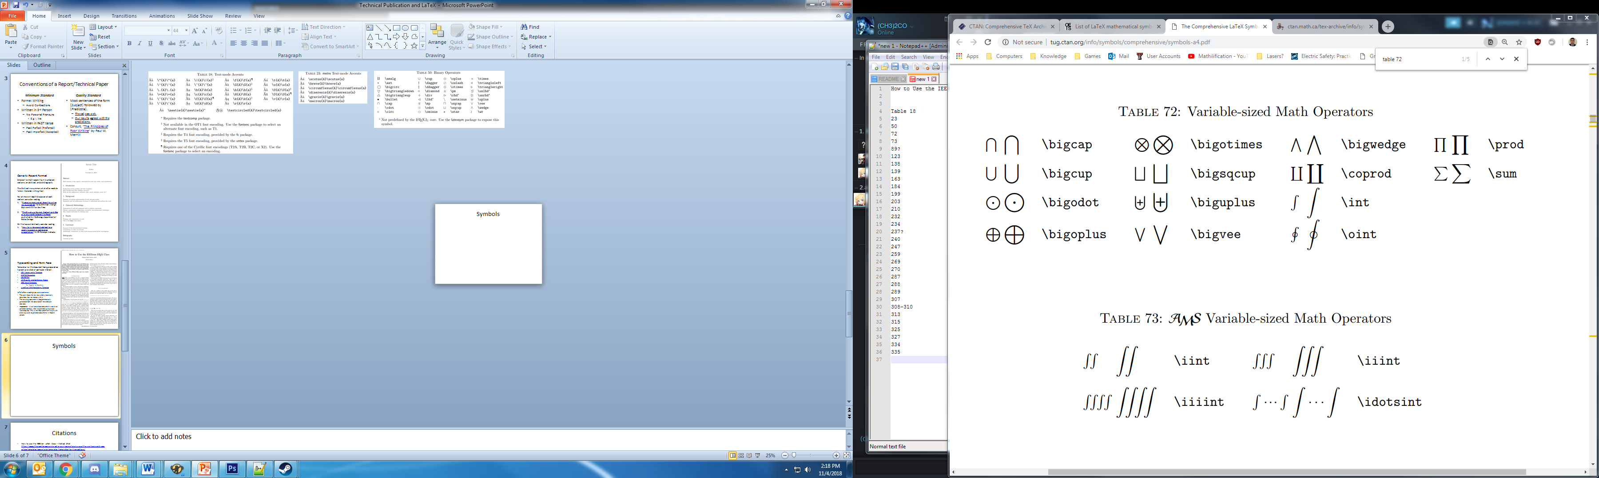
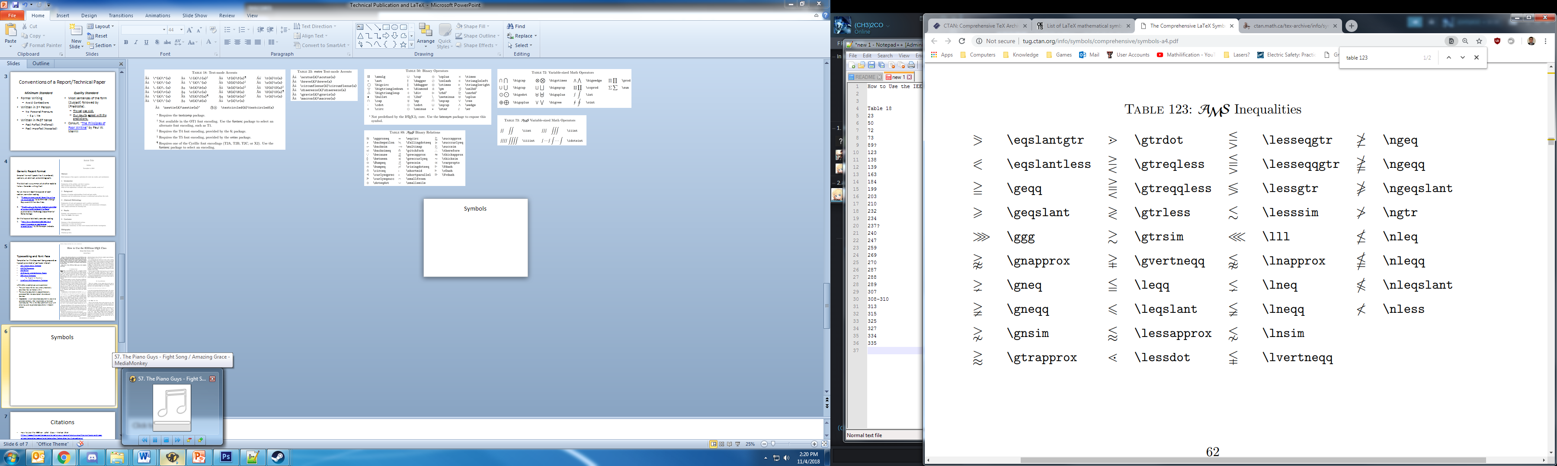
Symbols: Operators and Relations
All Tables are Taken From: “The Comprehensive LaTeX Symbol List” by Scott Pakin, January 19, 2017, online: http://tug.ctan.org/info/symbols/comprehensive/symbols-a4.pdf

Slide 29
Citations
“How to Use the IEEEtran LaTeX Class” by Michael Shell https://ieeeauthorcenter.ieee.org/create-your-ieee-article/use-authoring-tools-and-ieee-article-templates/ieee-article-templates/templates-for-transactions/
“The Comprehensive LaTeX Symbol List” by Scott Pakin, January 19, 2017, online: http://tug.ctan.org/info/symbols/comprehensive/symbols-a4.pdf

